Slide 1
2025 Market Outlook
The Great Moderation
--Rep Name
--Firm-Approved Title
--Registered Branch Address
--Approved Email and/or Registered Phone
--Securities Disclosure
Enter all information and submit to Ad Review for final approval
Notes:
Intro
Throughout history, major market events often earn memorable names. In the 1930s, we saw the Great Depression, and more recently, we had the Great Financial Crisis. While it’s usually the negative news events that get these attention-grabbing titles, if we were going to coin a name for what we expect in 2025, it would be the Great Moderation.

Slide 2
Primary Investment Themes
1
The Great Moderation
2
Fed is Not a Good Friend
3
Diversification is Rewarded
1
Notes:
Three primary investment themes

Slide 3
The Great Moderation
Notes:
As we approach the five-year anniversary of the pandemic’s onset in the United States, the economy is still moderating toward pre-pandemic levels. The pandemic and its aftermath disrupted supply chains, labor markets, inflation, and economic growth, leading to significant fluctuations across these indicators. These effects have rippled through stock and bond markets, shaping economic conditions for years.

Slide 4
Inflation Returning to Normal
Notes:
Inflation is moderating from high levels and getting closer to the Fed’s 2% target. Year-over-year, the Fed’s preferred measure of inflation is 2.7%. If we look at the last 3 and 6 months, it is heading in the right direction.

Slide 5
Participation Rate Elevated
Notes:
The labor market is also normalizing. After COVID disruptions the labor market participation rate is close to pre-dotcom bubble levels.

Slide 6
More Jobs Available Than People Looking
Notes:
The number job opening per job seeker has also come back down to earth after peaking around two job openings for every one person looking for work. This added to inflation pressures, but now these pressures are abating.

Slide 7
GDP Growth
Notes:
Looking at economic growth as measured by gross domestic product or GDP, grow is expected to cool further, but still be positive. Few economists are predicting a recession in 2025.

Slide 8
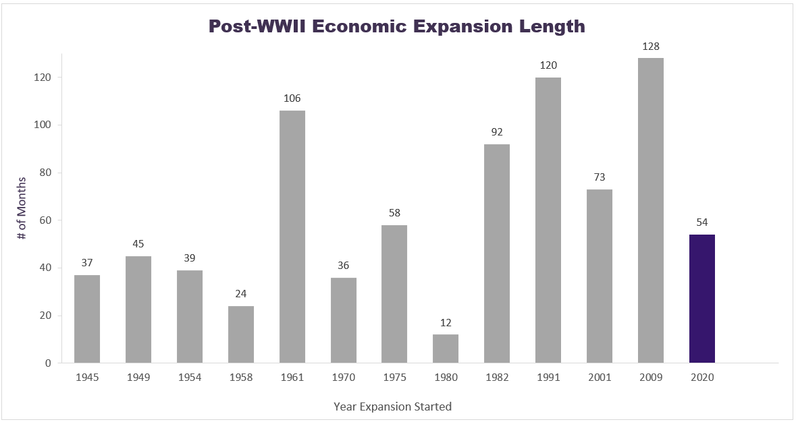
Mid Cycle Expansion?
Source: Cetera Investment Management, National Bureau of Economic Research (NBER). Data as of 10/31/2024.
Notes:
If we look at past economic expansions as a gauge, we could be in the middle of an economic expansion.

Slide 9
NBER Not Expecting Recession
Notes:
NBER – does not expect a recession.

Slide 10
The Fed is Not a Good Friend
Notes:
Last year we spoke about the Fed going from foe to friend and finally lowering interest rates. This became reality in September of 2024, but looking forward to 2025 while the Fed may be a friend to markets but might not be a good friend.

Slide 11
Are We Already Close to Neutral?
?
Post DotCom Bubble
Post Financial Crisis
Post COVID
Notes:
What we mean here is the Fed may not cut interest rates as much as many investors had anticipated. Looking at the past again, the Fed funds rates in the past 25 years have been distorted. Zero interest rates are not normal. The question now is what is normal? Typically, the Fed funds rate is a percent or two above the inflation rate, which could put us close to the neutral rate already.

Slide 12
Let’s Get Real
Notes:
Looking at real interest rates or the interest rate adjusted for inflation we are at 1.5%. You can see real rates were higher than this before the dot com bubble. Growth was higher then, so the neutral rate should be lower today as interest rate policy was restrictive and trying to stop the excesses of the 90s.

Slide 13
Did we “Whip” Inflation?
Notes:
Could inflation start to creep up again, as we saw in the 1970s? While it’s unlikely we’ll see “WIN” (Whip Inflation Now) pins making a comeback, inflation isn’t entirely gone. While inflation may be easing, it’s far from dead. The Producer Price Index appears to on the rise recently and if we add more tariffs to China, this could increase further. This could put the Fed in a bind as far as cutting rates.

Slide 14
Diversification is Rewarded
Notes:
Could 2025 be the year U.S. Large Cap Growth underperforms? This has been the outperformer in recent years as large tech stocks have carried the market higher on AI enthusiasm.

Slide 15
Concentration Risk
Notes:
This outperformance has distorted markets. The 10 ten stocks in the S&P 500 make up 35% of the weight of that index.

Slide 16
Elevated Valuations
Notes:
And it is these stocks that are causing valuations to be stretched. Their stocks have risen, but the earnings haven’t kept up.

Slide 17
Bonds Signaling Stronger Growth/Inflation… Less Rate Cuts?
September 18th
16
Notes:
Bond yields are climbing as bond investors want more yield to compensate for potentially higher economic growth and inflation. As bond yields rise, bond prices fall.

Slide 18
High Risk in High Yield?
Notes:
In high yield markets, investors are not demanding much extra yield for taking on extra credit risk. While it is telling us recession risk is low, it may be telling us high yield bond valuations are also stretched.

Slide 19
Valuations Not All the Same
Notes:
While large cap valuations appear stretched that is less of the case in mid and small cap stocks. We also see better valuations in international stocks.
International indexes also have less technology exposure than the S&P 500, a sector that has seen valuations soar. Keep in mind these international companies are not small French bakeries and German pubs; they are multi-national companies that you are likely familiar with ranging from oil companies to pharmaceuticals and automobile manufacturers. You likely even own a lot of these companies’ products.

Slide 20
Thank You!
@ceteraIM

Slide 21
Disclosures
About Cetera® Investment Management
Cetera Investment Management LLC is an SEC registered investment adviser owned by Cetera Financial Group®. Cetera Investment Management provides market perspectives, portfolio guidance, model management, and other investment advice to its affiliated broker-dealers, dually registered broker-dealers and registered investment advisers.
About Cetera® Financial Group
“Cetera Financial Group” refers to the network of independent retail firms encompassing, among others, Cetera Advisors LLC, Cetera Advisor Networks LLC, Cetera Investment Services LLC (marketed as Cetera Financial Institutions or Cetera Investors), and Cetera Financial Specialists LLC. All firms are members FINRA/SIPC. Located at 655 W. Broadway, 11th Floor, San Diego, CA 92101.
About Avantax
Avantax, Inc. (Avantax) is a wholly owned subsidiary of Aretec Group, Inc. (dba Cetera Holdings). Avantax is a unique community within Cetera Holdings. Avantax Investment Services, Inc., a subsidiary of Avantax, Member FINRA / SIPC. Located at 3200 Olympus Blvd, Suite 100, Dallas, TX, 75019.
Avantax and Cetera Financial Group are under common ownership.
Individuals affiliated with Cetera firms are either Registered Representatives who offer only brokerage services and receive transaction-based compensation (commissions), Investment Adviser Representatives who offer only investment advisory services and receive fees based on assets, or both Registered Representatives and Investment Adviser Representatives, who can offer both types of services.
For more information about Cetera Investment Management, please reference the Cetera Investment Management LLC Form ADV disclosure brochure and the disclosure brochure for the registered investment adviser your adviser is registered with. Please consult with your adviser for his or her specific firm registrations and programs available.
No independent analysis has been performed and the material should not be construed as investment advice. Investment decisions should not be based on this material since the information contained here is a singular update, and prudent investment decisions require the analysis of a much broader collection of facts and context. All information is believed to be from reliable sources; however, we make no representation as to its completeness or accuracy. The opinions expressed are as of the date published and may change without notice. Any forward-looking statements are based on assumptions, may not materialize, and are subject to revision.
All economic and performance information is historical and not indicative of future results. The market indices discussed are not actively managed. Investors cannot directly invest in unmanaged indices. Please consult your financial advisor for more information.
Additional risks are associated with international investing, such as currency fluctuations, political and economic instability, and differences in accounting standards.
A diversified portfolio does not assure a profit or protect against loss in a declining market.

Slide 22
Glossary
The S&P 500 is an index of 505 stocks chosen for market size, liquidity and industry grouping (among other factors) designed to be a leading indicator of U.S. equities and is meant to reflect the risk/return characteristics of the large cap universe.
The Russell 1000 Growth Index measures the performance of the large-cap growth segment of the U.S. equity universe. It includes those Russell 1000 Index companies with higher price-to-book ratios and higher forecasted growth values.
The Russell 1000 Value Index measures the performance of the large-cap value segment of the U.S. equity universe. It includes those Russell 1000 Index companies with lower price-to-book ratios and lower forecasted growth values.
The Chicago Board Options Exchange (CBOE) Volatility Index, commonly known by its ticker symbol VIX, is a measure of the stock market's expectation of volatility implied by S&P 500 index options.
The Bloomberg Barclays US Aggregate Bond Index is a broad based flagship benchmark that measures the investment grade, US dollar-denominated, fixed-rate taxable bond market. Eligible bonds must have at least one year until final maturity, but the index holdings have a fluctuating average life of around 8.25 years. This total return index is unhedged and rebalances monthly.
The ICE BofA US High Yield Index tracks the performance of US dollar denominated below investment grade rated corporate debt publicly issued in the U.S. domestic market. To qualify for inclusion in the index, securities must have a below investment grade rating (based on an average of Moody's, S&P, and Fitch) and an investment grade rated country of risk (based on an average of Moody's, S&P, and Fitch foreign currency long term sovereign debt ratings). Each security must have greater than 1 year of remaining maturity, a fixed coupon schedule, and a minimum amount outstanding of $100 million.
The Nasdaq Composite Index is a large, broad-based, market-cap-weighted index of more than 2,500 common equities listed on the Nasdaq stock exchange. It is often seen as a stand-in for the technology sector and its performance.

